Slide 1




Video games sales

Slide 2

Introduction
With the ever-growing popularity of video games, understanding the sales trends within the industry is crucial for game developers, publishers, and marketers.
This dataset provides a rich collection of information about video game sales, including attributes such as the game's title, platform, year of release, genre, publisher, and global sales.
To ensure accurate and meaningful analysis, it is essential to address any inconsistencies, missing values, or outliers present in the dataset. By implementing data cleaning techniques, we aim to enhance the dataset's reliability and usability.
Furthermore, preprocessing the data will involve transforming and structuring it in a way that allows for effective analysis and visualization. Once the cleaning and preprocessing stages are complete, we will delve into exploring and analyzing the dataset.

Slide 3
Cleaning the data
To clean the data, we utilized Excel as our primary tool for data preparation and transformation. First, we converted the original CSV format to Excel format to leverage its functionalities effectively.
We then addressed data quality issues by removing null and blank values, eliminating unknown years, and converting sales figures to a uniform format (millions).
To focus our analysis, we limited the dataset to the top 10 publishers, ensuring a comprehensive examination of industry leaders.
Additionally, we carefully scanned and eliminated any duplicate entries to maintain data integrity. These steps in Excel allowed us to create a refined and reliable dataset, laying the groundwork for an accurate and insightful. analysis of the video game sales industry.

Slide 4
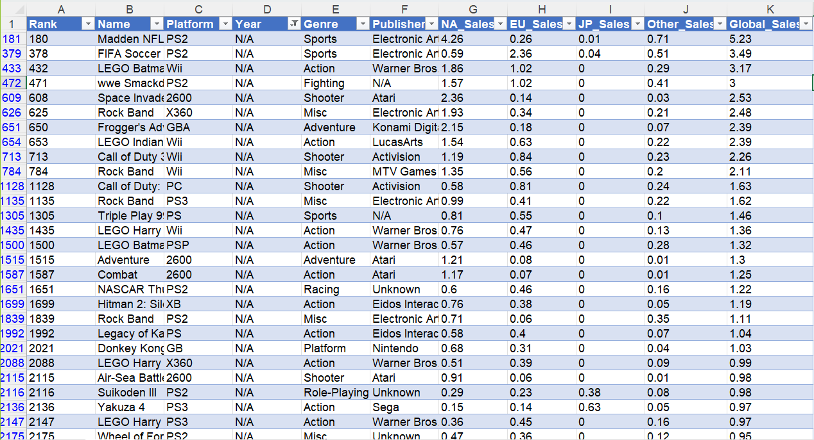
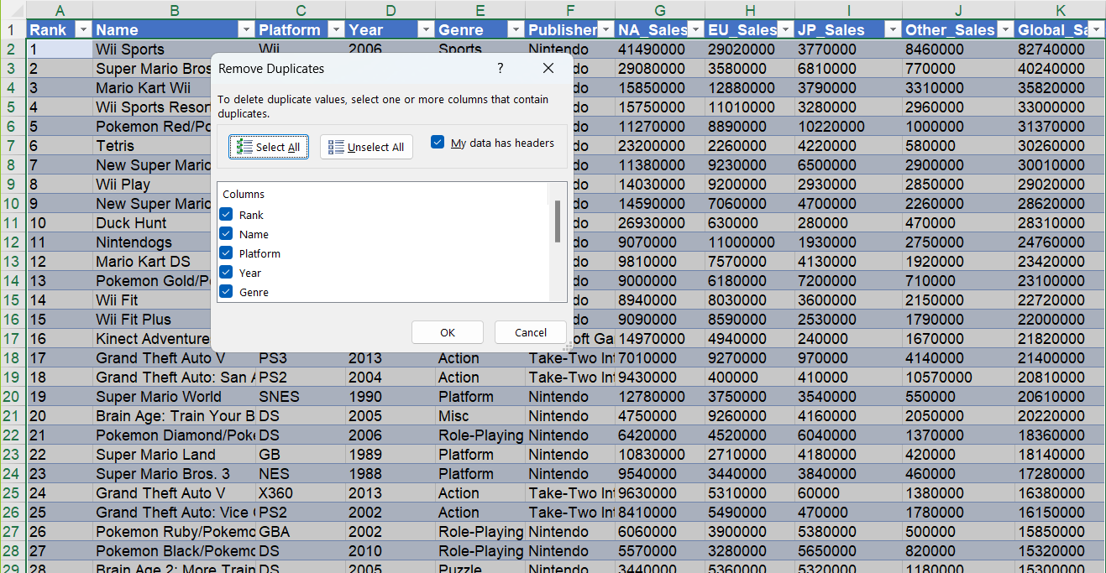
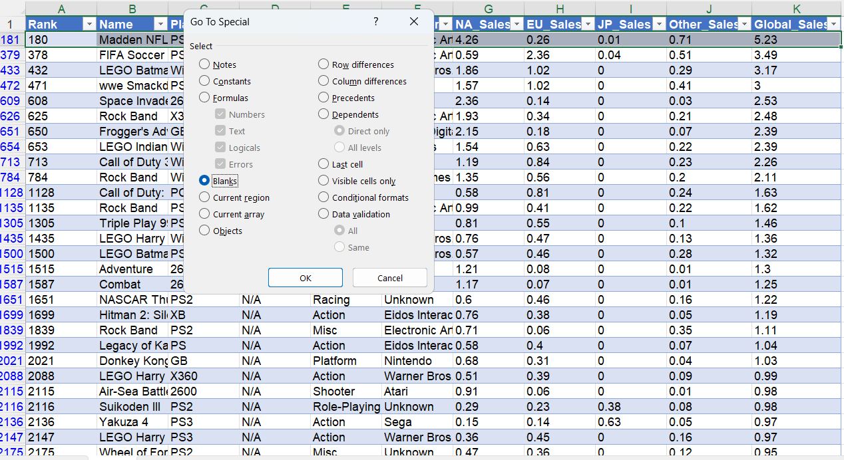
Before cleaning

Slide 5
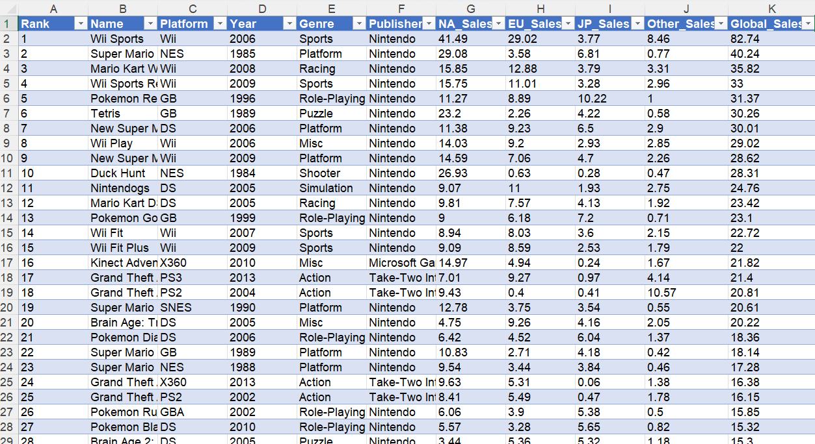
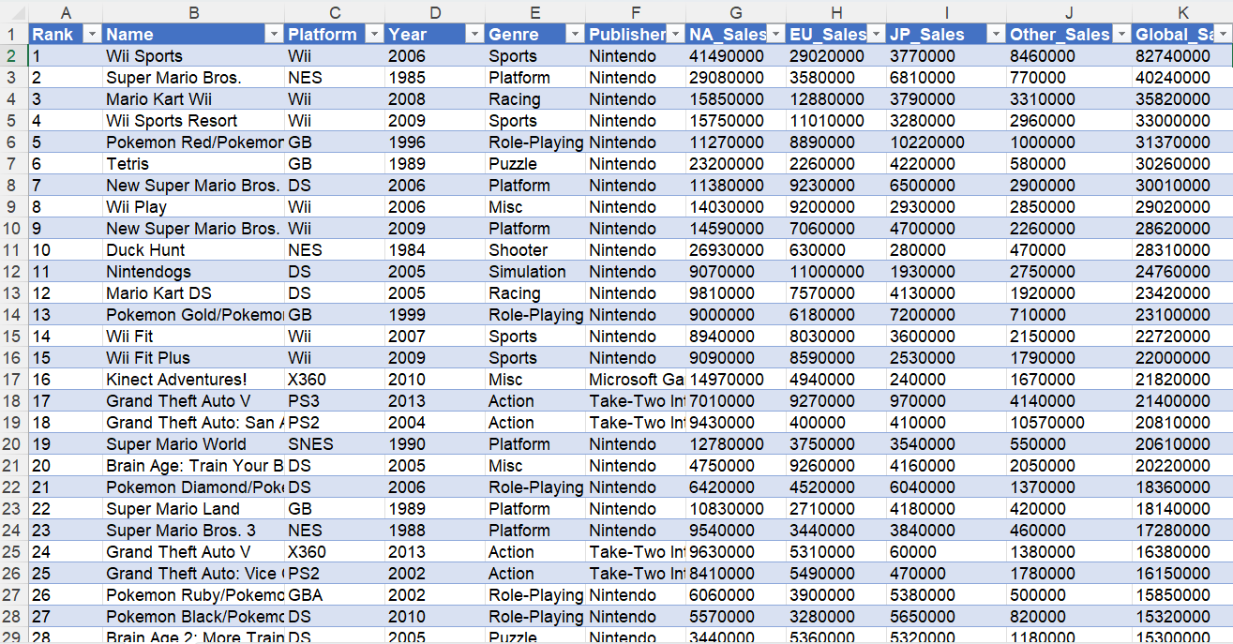
After Cleaning

Slide 6
Analyze the dataset
Analysis by Number of Games, Total platforms and Total Sales: We examined the dataset to determine the number of games available and calculated the total sales across all games. This analysis provided a comprehensive overview of the dataset's scope and the overall sales volume.

Slide 7
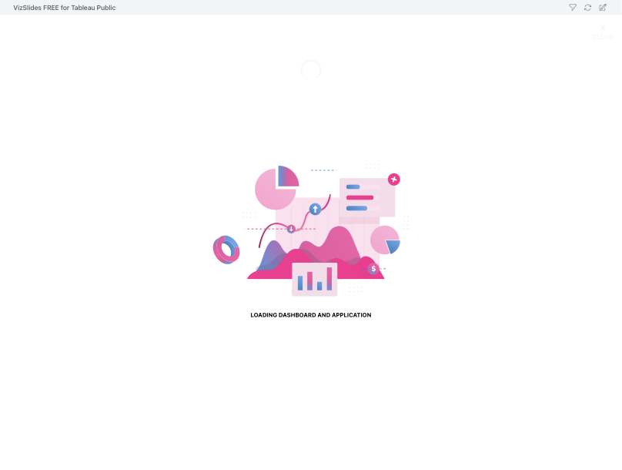

Slide 8
Analyze the dataset
Value of Each Sale in the countries in Top 5 Years: We focused on the top 5 years with the highest sales in the countries and analyzed the value of each sale during those years. This analysis allowed us to identify the highest sales in the countries within each and understand the revenue generated within those periods.

Slide 9
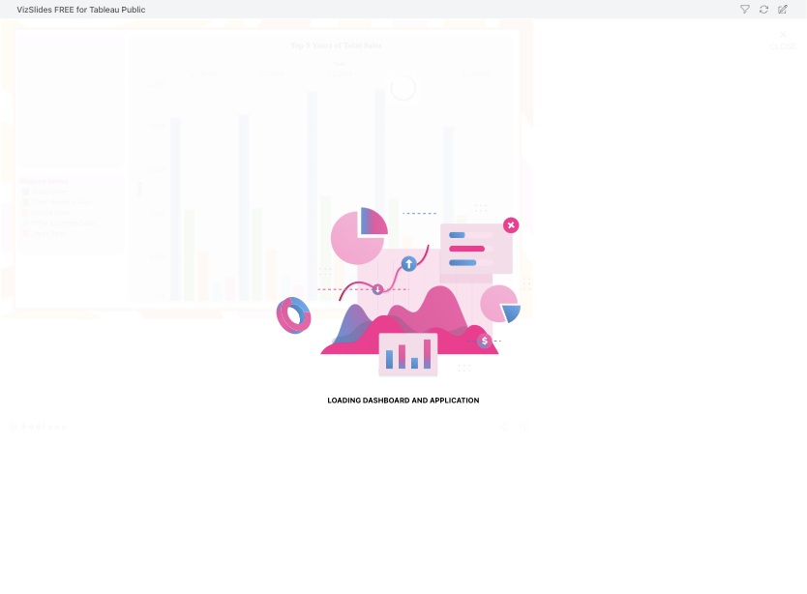

Slide 10
Analyze the dataset
Top 10 Platforms Based on Total Sales: We determined the platforms with the highest total sales by analyzing the dataset. This analysis helped identify the most popular and commercially successful gaming platforms, providing valuable insights for developers and marketers.

Slide 11
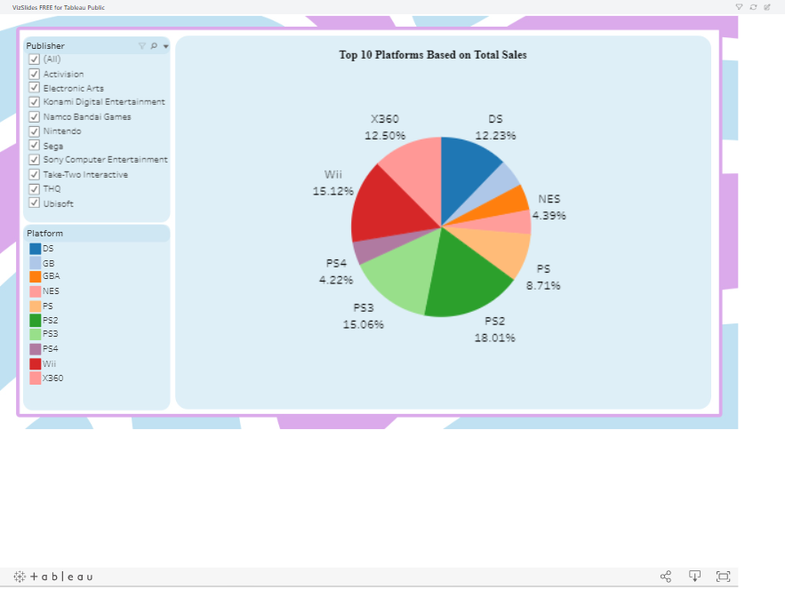

Slide 12
Analyze the dataset
Genre Analysis Based on Number of Games: By examining the dataset's genre attribute, we analyzed the number of games falling within each genre category. This analysis allowed us to identify the most prevalent and sought-after genres in the video game industry.

Slide 13
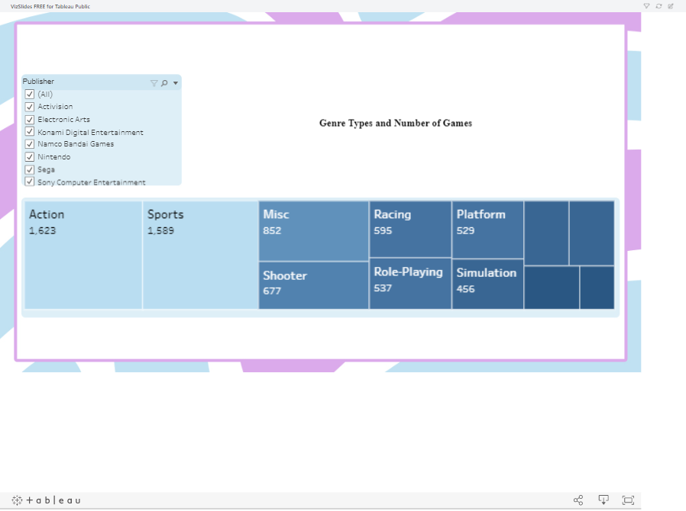

Slide 14
Analyze the dataset
KPI of the profit in Total Sales Analysis Based on Years: We further explored the dataset by examining the total sales figures across different years. This analysis revealed the profit between the last year and the year before it which was between 2016 & 2017.

Slide 15
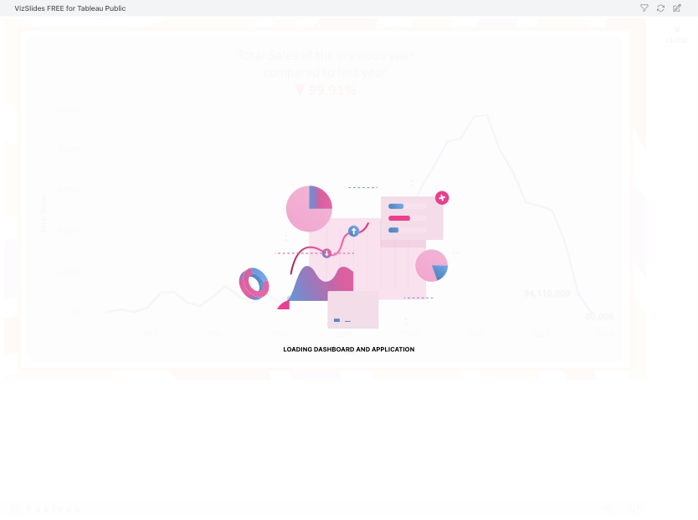

Slide 16
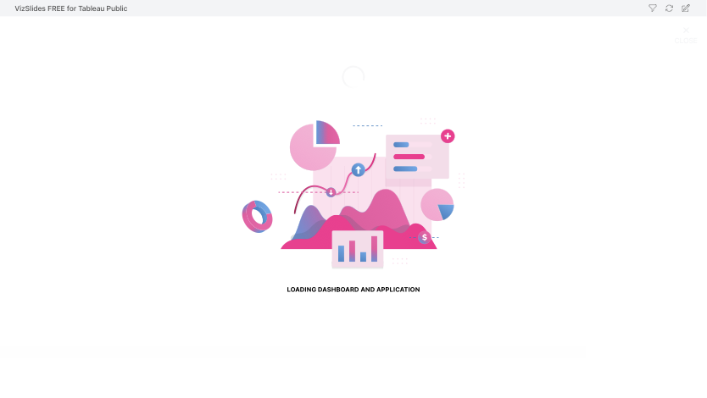

Slide 17
Powerful Tools Used In Tableau
Tableau provides powerful tools for enhancing visualization flexibility and control
we implemented a filter for the publisher names. This allowed us to selectively view and analyze data based on specific publishers, enabling us to gain a more focused understanding of their performance in the video game market.
Tableau enables visual analysis, supporting the exploration of data through visual storytelling. This feature facilitates the communication of insights on the fly and helps users stay in the flow of analysis.
Tableau allows users to transform data analysis into visually compelling representations such as charts, graphs, and histograms.
It also offers performance metrics enabling the comparison of the data.
Tableau also facilitates easy collaboration and sharing among the group as we can invite each other and choose the responsibilities. By allowing seamless communication and real-time exchange of data.

Slide 18
THANK YOU

